Slide 1
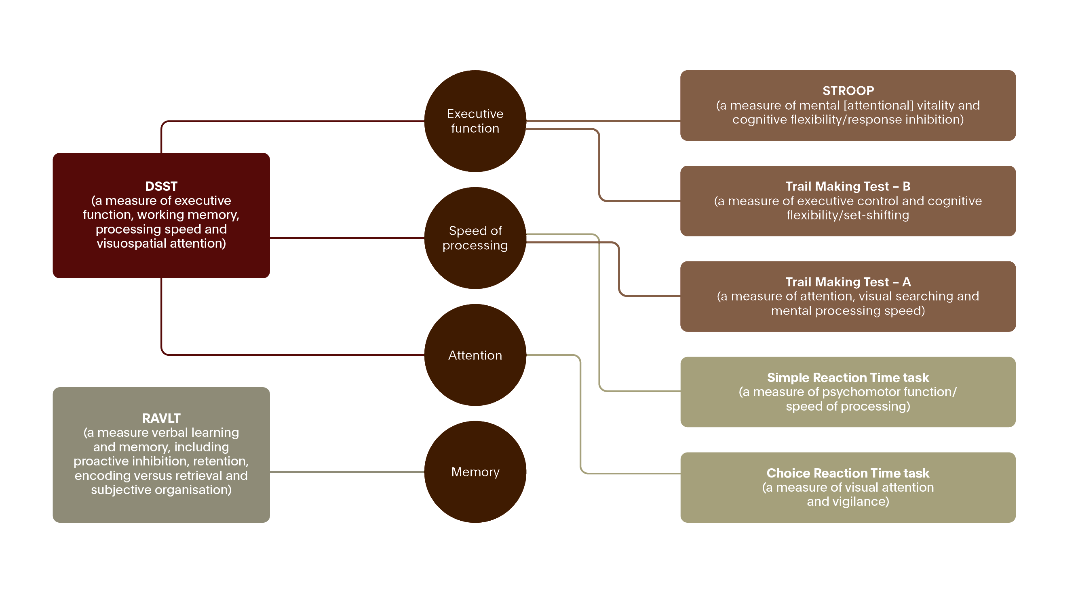
Notes:
The slide represents a hypothetical model for the pathological-clinical continuum of AD.^{[Sperling et al., 2011]}
The ‘preclinical’ stage precedes mild cognitive impairment (MCI) and includes individuals who have evidence of early AD pathological changes, but do not meet clinical criteria for MCI or dementia.^{[Sperling et al., 2011]} It is likely that even this preclinical stage of the disease represents a continuum from completely asymptomatic individuals with biomarker evidence suggestive of AD-pathophysiological process at risk for progression to AD dementia to biomarker-positive individuals who are already demonstrating very subtle decline but not yet meeting standardized criteria for MCI.^{[Sperling et al., 2011]} This continuum of preclinical AD would also encompass:
individuals who carry one or more apolipoprotein E (APOE) ε4 alleles who are known to have an increased risk of developing AD dementia, at the point they are AD-P biomarker-positive
carriers of autosomal-dominant mutations, who are in the presymptomatic biomarker-positive stage of their illness, and who will almost certainly manifest clinical symptoms and progress to dementia.^{[Sperling et al., 2011]}
Emerging evidence from both genetic at-risk and aging cohorts suggests that there may be a time lag of a decade or more between the beginning of the pathological cascade of AD and the onset of clinically evident impairment.^{[Sperling et al., 2011]} It has been proposed that AD begins with a long asymptomatic period, during which the pathophysiological process is progressing, and that individuals with biomarker evidence of early AD-pathophysiological process are at increased risk for developing cognitive and behavioral impairment and progression to clinically manifest AD dementia.^{[Sperling et al., 2011]}
Reference:
Sperling RA, Aisen PS, Beckett LA, et al. Toward defining the preclinical stages of Alzheimer’s disease: recommendations from the National Institute on Aging-Alzheimer’s Association workgroups on diagnostic guidelines for Alzheimer’s disease. Alzheimers Dement 2011; 7 (3): 280–292.

